Slide 1
Project based lab report on Obstacle detection robot
Ravi Shankar Palle
190050045

Slide 2
contents
List of Figures
Abstract
Introduction
Project Description
Code
Outputs
Discussions and Conclusions
References

Slide 3
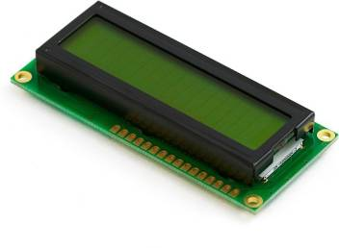
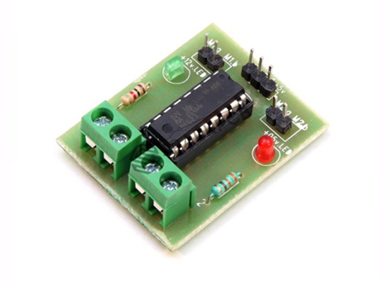
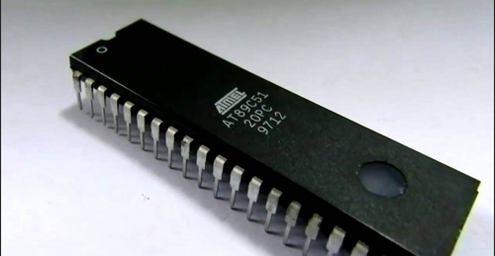
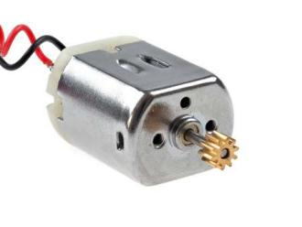
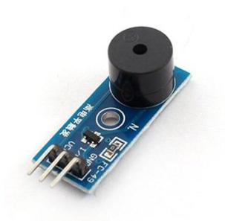
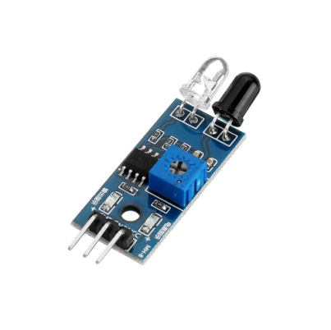
List of figures
LCD
L293D Motor Driver
AT89c51 Microcontroller
Motor
Buzzer
IR Sensor

Slide 4
Abstract
In today’s world ROBOTICS is a fast growing and interesting field. ROBOT has sufficient intelligence to cover the maximum area of provided space. It has an infrared sensor which is used to sense the obstacles coming in between the path of ROBOT. It will move in a particular direction and detect the obstacle which is coming in its path. Autonomous Intelligent Robots are robots that can perform desired tasks in unstructured environments without continuous human guidance. The minimum number of gear motor allows the walking robot to minimize the power consumption while construct a program that can produce coordination of multi-degree of freedom for the movement of the robot. It is found that two gear motors are sufficient to produce the basic walking robot and one voltage regulators are needed to control the load where it is capable of supplying enough current to drive two gear motors for each wheel.
Key words: Autonomous, Intelligent, Robots, Gear motors.

Slide 5
introduction
Now a day’s Robotics is part of today’s communication & communication is part of advancement of technology, so we decided to work on ROBOTICS field, and design something which will make human life today’s aspect. There are different types of mobile robots which can be divided into several categories consists of wheeled robot, crawling robot and legged robot. This project deals with a wheeled autonomous ROBOT. It is the part of Automation; Robot has sufficient intelligence to cover the maximum area. This robot uses infrared sensor to detect the obstacle in between the path and then avoid them to complete its objective. The IR transmitter continuously generate an Infrared signal of 38KHz,when an obstacle comes in the path the infrared signal reflected back from the object and is received by the IR sensor and then generate a positive high signal with the help of the receiver circuit that is there is an obstacle in the path. In such a way the robot is able to detect obstacles of provided space and able to avoid obstacles coming in between the path of ROBOT with the help microcontroller board and complete its journey.
The main motto of designing such type of Robot or the technology is that this technology can be used in today’s very fast transportation to avoid the accident generally happen in congested or the Metro Politian Areas by applying emergency break. If we use this technology in the car or any vehicle, it will automatically sense the obstacles then it will take a side to the available free space. An obstacle may be a living things or any object. Autonomous Intelligent Robots are robots that can perform desired tasks in unstructured environments without continuous human guidance. Thus by using this technology in vehicles we make the drive safe.

Slide 6
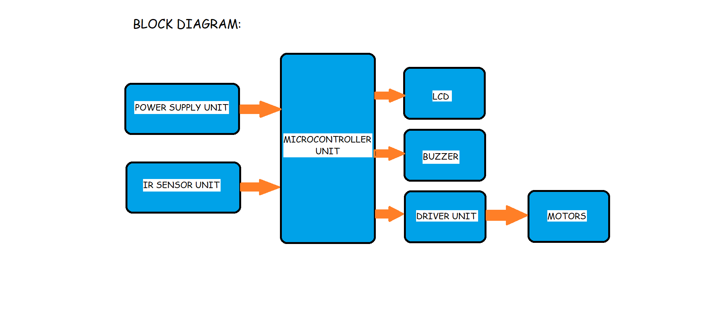
Block diagram
Overall Block Diagram of the Robot

Slide 7
Project description
The IR sensors are used for obstacle detection. The sensor output signal sends to the microcontroller. The microcontroller controls the vehicle (forward/back/stop) by using the DC motor which is placed in the vehicle. If any obstacle placed inline the IR sensor fails to receive the light rays and gives signals to the microcontroller. The microcontroller will stop the vehicle immediately and the siren will on. After one minute the robot will check the path status if an obstacle is removed the robot moves far word else the robot will return to move starting place. The sensor detects objects by emitting a short ultrasonic burst and then listening for the eco. Under the control of a host microcontroller, the sensor emits a short 40 kHz explosion. This explosion ventures or travels through the air hits an article and after that bounces once again to the sensor. The sensor provides an output pulse to the host that will terminate when the echo is detected; hence the width of one pulse to the next is taken into the calculation by a program to provide results in a distance of the object.

Slide 8
code
#include<reg51.h>
sbit rs=P3^4;
sbit rw=P3^5;
sbit en=P3^7;
sbit mot1p=P3^0;
sbit mot1n=P3^1;
sbit mot2p=P3^2;
sbit mot2n=P3^3;
sbit sensor=P1^0;
sbit buz=P1^1;
void lcddat(unsigned char);
void lcdcmd(unsigned char);
void lcddis(unsigned char *);
void lcdinit();
void delay();
void main()
{
mot1p=mot1n=mot2p=mot2n=0;
buz=0;
lcdinit();
lcddis("OBSTACLE DETECT");
lcdcmd(0Xc0);

Slide 9
code
lcddis("ION ROBOT ");
delay();
while(1)
{
lcdcmd(0x01);
lcddis("ROBOT IS MOVING");
delay();
mot1p=mot2p=1;
mot1n=mot2n=0;
buz=0;
if(sensor==1)
{
mot1p=mot1n=mot2p=mot2n=0;
buz=1;
lcdcmd(0Xc0);

Slide 10
code
lcddis("OBSTACLE DETECTED");
delay();
{
lcdcmd(0x01);
lcddis("ROBOT STOPPED");
}
while(sensor==1);
}
}
}
void lcdinit()
{
lcdcmd(0X38);
lcdcmd(0X10);
lcdcmd(0X06);
lcdcmd(0X0c);
lcdcmd(0X80);
}
void lcddis(unsigned char *s)
{

Slide 11
code
unsigned char w;
for(w=0;s[w]!='\0';w++)
{
lcddat(s[w]);
}
}
void lcddat(unsigned char val)
{
P2=val;
rs=1;
rw=0;
en=1;
delay();
en=0;
}

Slide 12
code
void lcdcmd(unsigned char val)
{
P2=val;
rs=0;
rw=0;
en=1;
delay();
en=0;
}
void delay()
{
unsigned int v;
for(v=0;v<3000;v++);
}

Slide 13
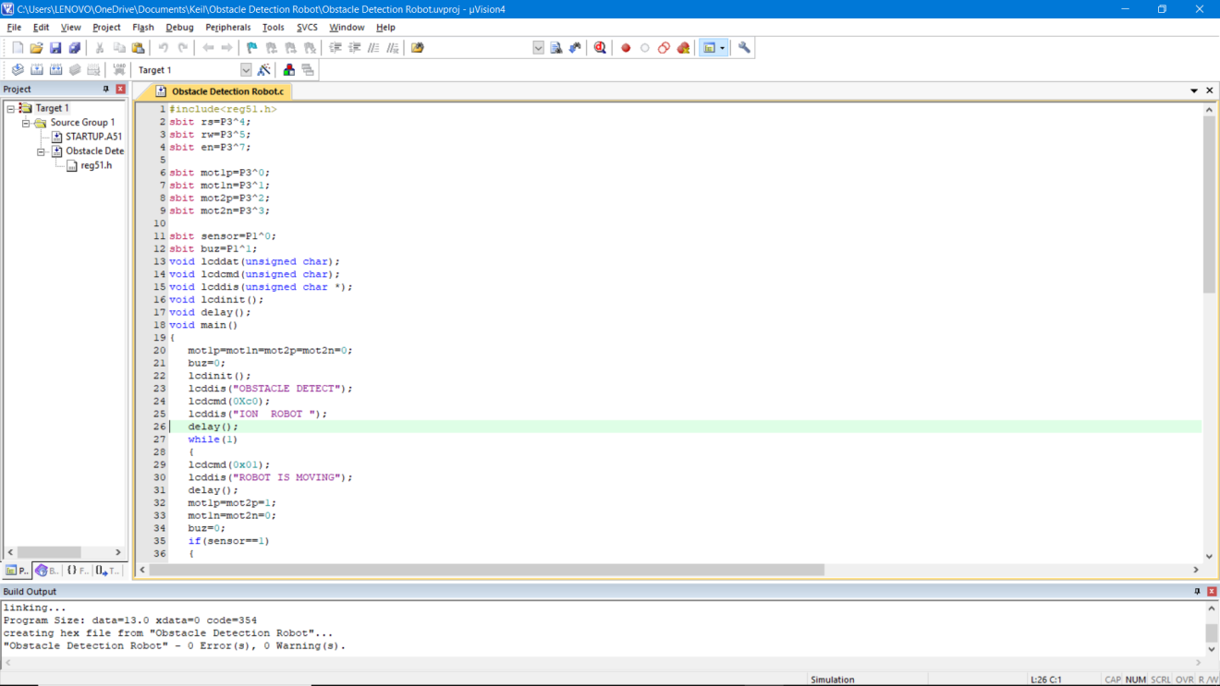
Keil output
KEIL Output for Obstacle Detection Robot

Slide 14
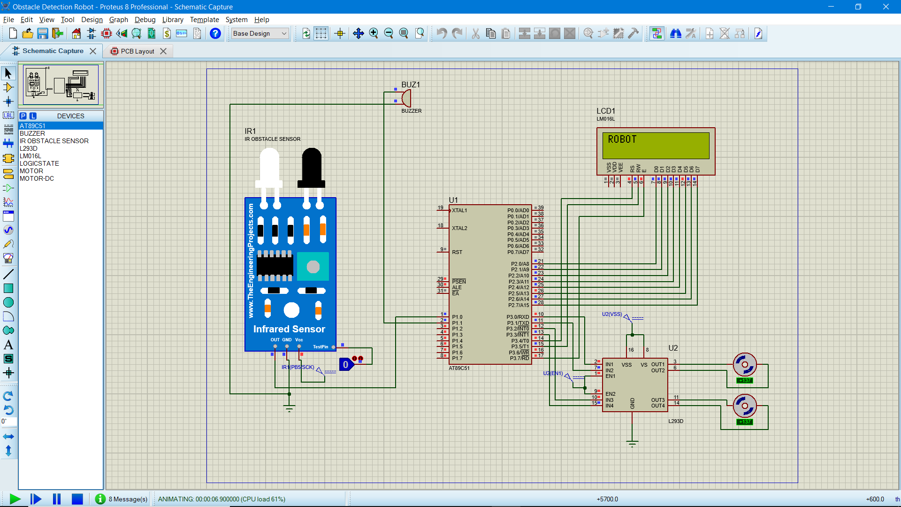
Proteus outputs
Obstacle Detection Robot – Robot is moving

Slide 15

Proteus outputs
Obstacle Detected – Robot Stopped

Slide 16
discussions
The obstacle detection robot helps us to detect the obstacles when we are travelling. Now-a-days accidents are occurring due to these obstacles on the road, so many are driving fast on the roads, this robot helps us to detect the obstacles and avoid the accidents.
The working of the robot is based on the IR sensor and motor driver. The obstacle detection robot works according to the principle we given. When the obstacle is detected the robot automatically stops and alerts us with the help of the buzzer. When the obstacle is removed the robot automatically starts moving. We can observe the outputs.

Slide 17
conclusion
From this study, a walking robot that achieved the stated objectives had been developed. This robot is able to produce the basic walking movements using two gear motors. We developed the robot with a very good intelligence which is easily capable to sense the obstacle and it is perfectly detecting the obstacle coming in between the path. Robot will take the left or right or the forward movement in according to the signal with the help of the two gear motors which makes the movement of the robot smooth. In future, the sensing range can be increased by increasing the sensor quality with the help of ultrasonic sensor or the IR signal spread all over the provide area.

Slide 18
references
[1] N. Senthil Kumar, M.Saravanan, S Jeebananthan ,“Microprocessors & Microcontrollers”, Oxford University Press,4th Edition,2012,ISBN:978-0- 19-806647-7
[2] B. Ram, “Fundamental of Microprocessors & Microcontrollers”, Dhanpat Rai Publication, Seventh Edition, ISBN:978-81-89928-60-5
[3] M. C. Lam, A. S. Prabuwono, H. Arshad, C. S. Chan, “A Real-Time Vision-Based Framework for Human-Robot Interaction”, , 7066Lecture Notes .in Computer Science (Part 1),2011, pp. 257-267, IVIC 2011.
[4] T. Ishida, and Y. Kuroki, “Sensor System of a small Biped Entertainment Robot”, Advanced Robotics, © VSP and Robotics Society of Japan, Vol. 18, No. 10, pp 1039-1052, 2004,.
[5] Maikoto T., Koji Y., and Satoshi E., “Studies on Forward Motion of Five Legs Robot”, Journal Cooperative Intelligent Robotics in space-II SPIE vol. 1612, Boston, Nov 1991. Code: L0318B 2005, 2P1-S-065, 2005.
[6] Proceedings of A. R. A Besari, R. Zamri, A. S. Prabuwono, and S. Kuswadi, “The Study on Optimal Gait for Five-Legged Robot with Reinforcement Learning”, Intelligent .Robotics and Applications, , Vol. 5928, pp. 1170-1175, 2009

